Slide 1
Stochastic Signal Processing
Experiment 3

Slide 2
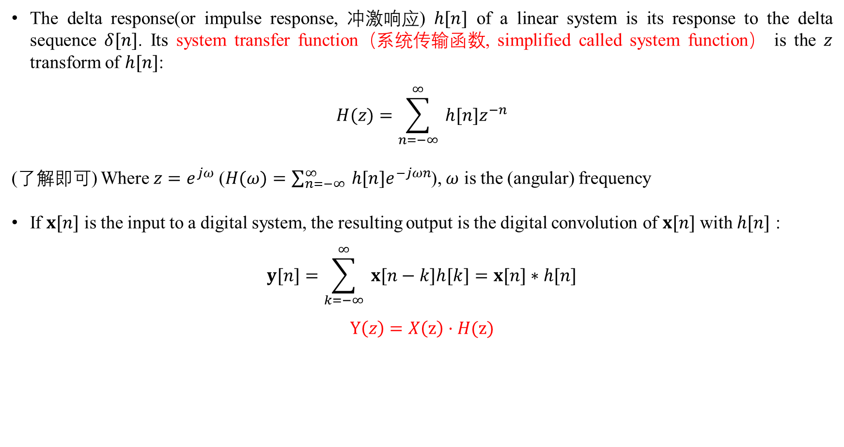
Discrete-time process – linear system (page 8 of lesson 10)
The delta response(or impulse response, 冲激响应) $h[n]$ of a linear system is its response to the delta sequence $δ[n]$. Its system transfer function（系统传输函数, simplified called system function） is the $z$ transform of $h[n]$:
$$H(z)=\sum_{n=−∞}^{∞}{ }h[n]z^{−n}$$
(了解即可) Where $z=e^{jω}$ ($H(ω)=\sum_{n=−∞}^{∞}{ }h[n]e^{−jωn}$), $ω$ is the (angular) frequency
If $x[n]$ is the input to a digital system, the resulting output is the digital convolution of $x[n]$ with $h[n]$ :
$$y[n]=\sum_{k=−∞}^{∞}{ }x[n−k]h[k]=x[n]∗h[n]$$
$$Y\left(z\right)=X\left(z\right)·H(z)$$

Slide 3
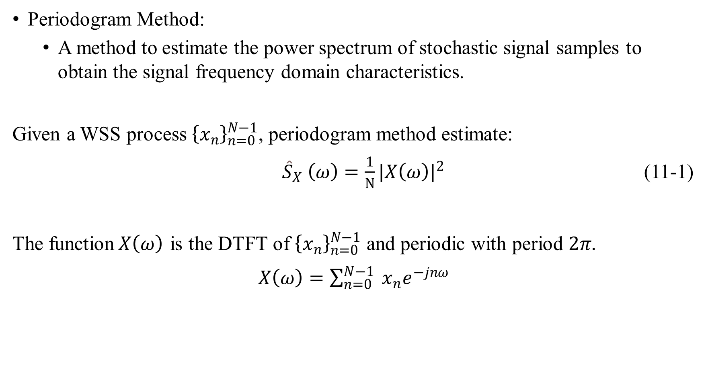
Power spectrum
Periodogram Method:
A method to estimate the power spectrum of stochastic signal samples to obtain the signal frequency domain characteristics.
Given a WSS process ${\left\{x_{n}\right\}}_{n=0}^{N−1}$, periodogram method estimate:
${\hat{S}}_{X} \left(ω\right)=\frac{1}{N}{|X\left(ω\right)|}^{2}$ (11-1)
The function$X\left(ω\right)$ is the DTFT of ${\left\{x_{n}\right\}}_{n=0}^{N−1}$ and periodic with period $2π.$
$X\left(ω\right)=\sum_{n=0}^{N−1}{ }x_{n}e^{−jnω}$

Slide 4
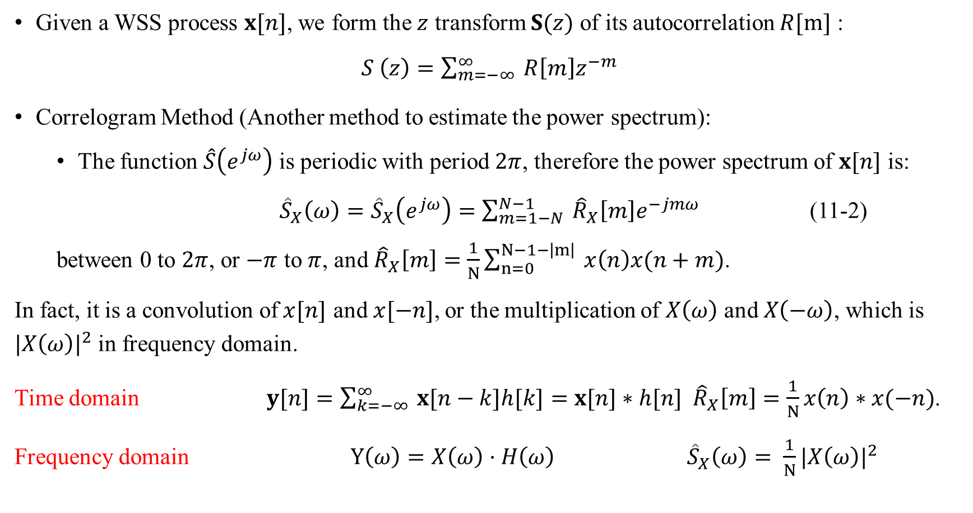
Discrete-time process – Power spectrum (page 10 of lesson 10)
Given a WSS process $x[n]$, we form the $z$ transform $S(z)$ of its autocorrelation $R[m]$ :
$S \left(z\right)=\sum_{m=−∞}^{∞}{ }R\left[m\right]z^{−m}$
Correlogram Method (Another method to estimate the power spectrum):
The function $\hat{S}\left(e^{jω}\right)$ is periodic with period $2π$, therefore the power spectrum of $x[n]$ is:
${\hat{S}}_{X}\left(ω\right)={\hat{S}}_{X}\left(e^{jω}\right)=\sum_{m=1−N}^{N−1}{ }{\hat{R}}_{X}\left[m\right]e^{−jmω}$ (11-2)
between 0 to $2π$, or $−π$ to $π$, and ${\hat{R}}_{X}\left[m\right]=\frac{1}{N}\sum_{n=0}^{N−1−\left|m\right|}{ }x\left(n\right)x(n+m)$.
In fact, it is a convolution of$x[n]$ and$x[−n]$, or the multiplication of $X\left(ω\right)$ and $X\left(−ω\right)$, which is ${|X\left(ω\right)|}^{2}$in frequency domain.
Time domain $y[n]=\sum_{k=−∞}^{∞}{ }x[n−k]h[k]=x[n]∗h[n]$ ${\hat{R}}_{X}\left[m\right]=\frac{1}{N}x\left(n\right)∗x(−n)$.
Frequency domain $Y\left(ω\right)=X\left(ω\right)·H\left(ω\right)$ ${\hat{S}}_{X}\left(ω\right)=$ $\frac{1}{N}{|X\left(ω\right)|}^{2}$

Slide 5

Power spectrum
More about the Autocorrelation:
$${\hat{R}}_{X}\left[m\right] =α\sum_{n=0}^{N−1−\left|m\right|}{ }x\left(n\right)x(n+m)$$
When $α$= $\frac{1}{N}$ , the estimation is biased. Therefore
$E\left({\hat{R}}_{X}\left[m\right]\right)=\frac{N−|m|}{N}R_{X}\left[m\right]$ = $w_{N}\left(n\right)R_{X}\left[m\right]$
And $E\left({\hat{S}}_{X}\left(ω\right)\right)=\sum_{m=1−N}^{N−1}{w_{N}\left(m\right)R_{X}\left[m\right] e^{−jmω}}$

Slide 6
Experiment – power spectrum
Function periodogram in Matlab
pxx = periodogram(x) % using the default rectangular window and returns the periodogram power spectral density (PSD) estimate
pxx = periodogram(x, window, nfft) %uses nfft points in the discrete Fourier transform (DFT).
Common window function in matlab
name | Matlab function
矩形窗 | rectwin
三角窗 | triang
Hamming | hamming

Slide 7
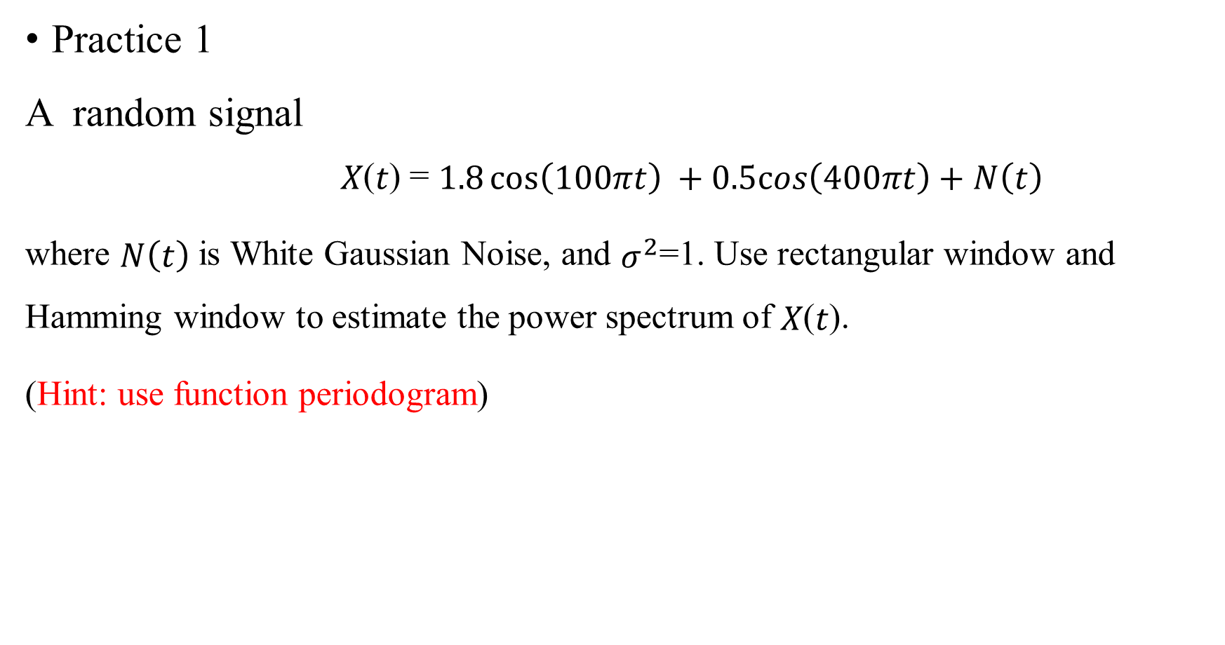
Experiment – power spectrum
Practice 1
A random signal
𝑋(𝑡) = $1.8\cos\left(100πt\right) +0.5cos\left(400πt\right)+N\left(t\right)$
where $N\left(t\right)$ is White Gaussian Noise, and $σ^{2}$=1. Use rectangular window and Hamming window to estimate the power spectrum of 𝑋(𝑡).
(Hint: use function periodogram)

Slide 8
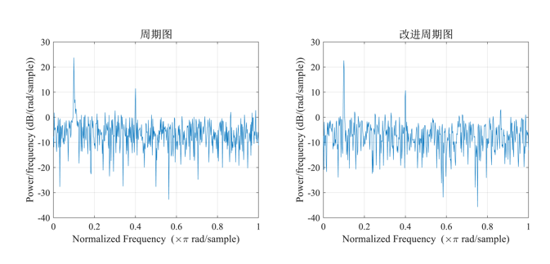
Experiment – power spectrum
fs = 1000; % sample rate
f1 = 50; %
f2 = 200; %
t = 0:1/fs:1-1/fs; % sample point
x = 1.8*cos(2*pi*f1*t)+0.5*cos(2*pi*f2*t) + randn(size(t)); % length 1s
subplot(1,2,1)
periodogram(x,rectwin(length(x))); % Periodogram with rectangular Window
set(gca,'fontsize',12,'fontname','times');
title('\fontname{} Periodogram ','fontsize',14);
subplot(1,2,2)
periodogram(x,hamming(length(x))); % Periodogram with Hamming Window
set(gca,'fontsize',12,'fontname','times');
title('\fontname{} Modified Periodogram','fontsize',14);
set(gcf,'Units','centimeter','Position',[10 10 28 10]);

Slide 9

Experiment – power spectrum
Practice 1
Formula: $ω$ = 2 $π$ $f/$ $f_{s}$
Maximum values appear in $ω$=0.1$π$ and $ω$=0.4$π$, corresponding to $f$=50$Hz$and 𝑓=200Hz,
Hamming window is able to reduce side lobe, especially in 𝜔=0.1𝜋 .

Slide 10
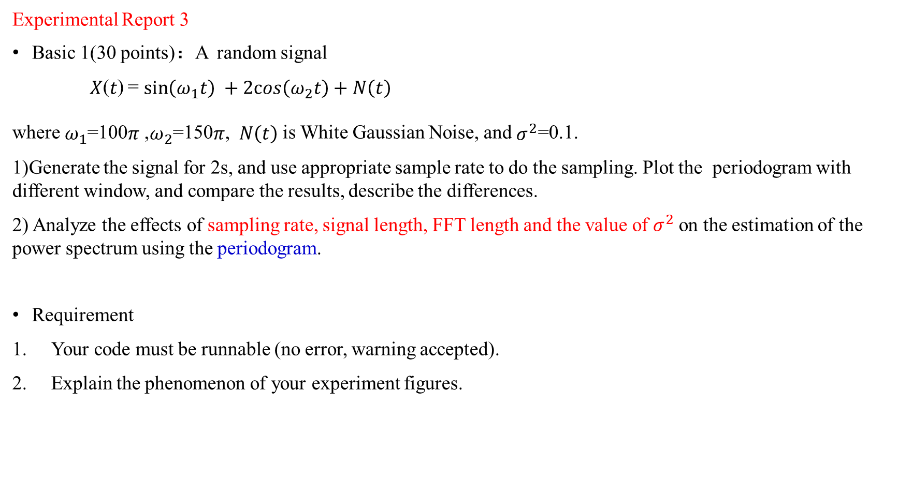
Experimental Report 3
Basic 1(30 points)：A random signal
𝑋(𝑡) = $\sin\left(ω_{1}t\right) +2cos\left(ω_{2}t\right)+N\left(t\right)$
where $ω_{1}$=100$π$ ,$ω_{2}$=150$π$, $N\left(t\right)$ is White Gaussian Noise, and $σ^{2}$=0.1.
1)Generate the signal for 2s, and use appropriate sample rate to do the sampling. Plot the periodogram with different window, and compare the results, describe the differences.
2) Analyze the effects of sampling rate, signal length, FFT length and the value of $σ^{2}$on the estimation of the power spectrum using the periodogram.
Requirement
Your code must be runnable (no error, warning accepted).
Explain the phenomenon of your experiment figures.

Slide 11
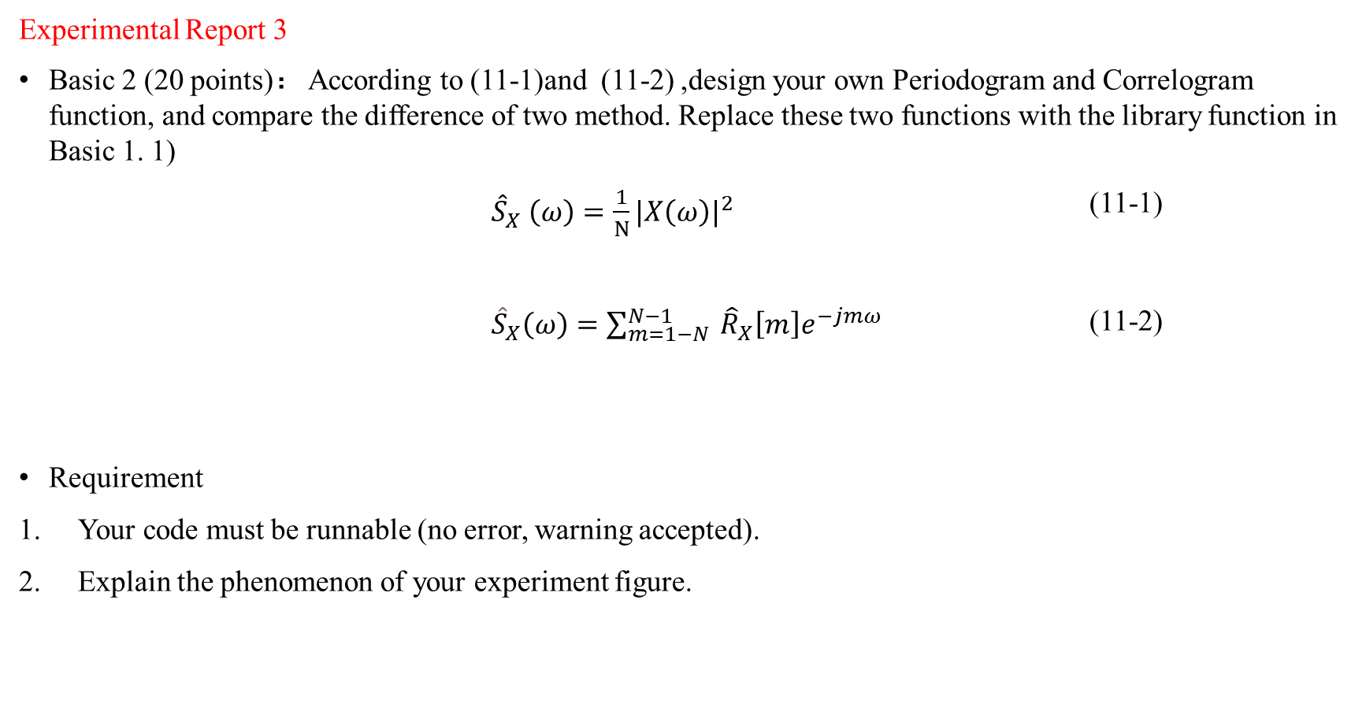
Experimental Report 3
Basic 2 (20 points)： According to (11-1)and (11-2) ,design your own Periodogram and Correlogram function, and compare the difference of two method. Replace these two functions with the library function in Basic 1. 1)
${\hat{S}}_{X} \left(ω\right)=\frac{1}{N}{|X\left(ω\right)|}^{2}$ (11-1)
${\hat{S}}_{X}\left(ω\right)=\sum_{m=1−N}^{N−1}{ }{\hat{R}}_{X}\left[m\right]e^{−jmω}$ (11-2)
Requirement
Your code must be runnable (no error, warning accepted).
Explain the phenomenon of your experiment figure.

Slide 12

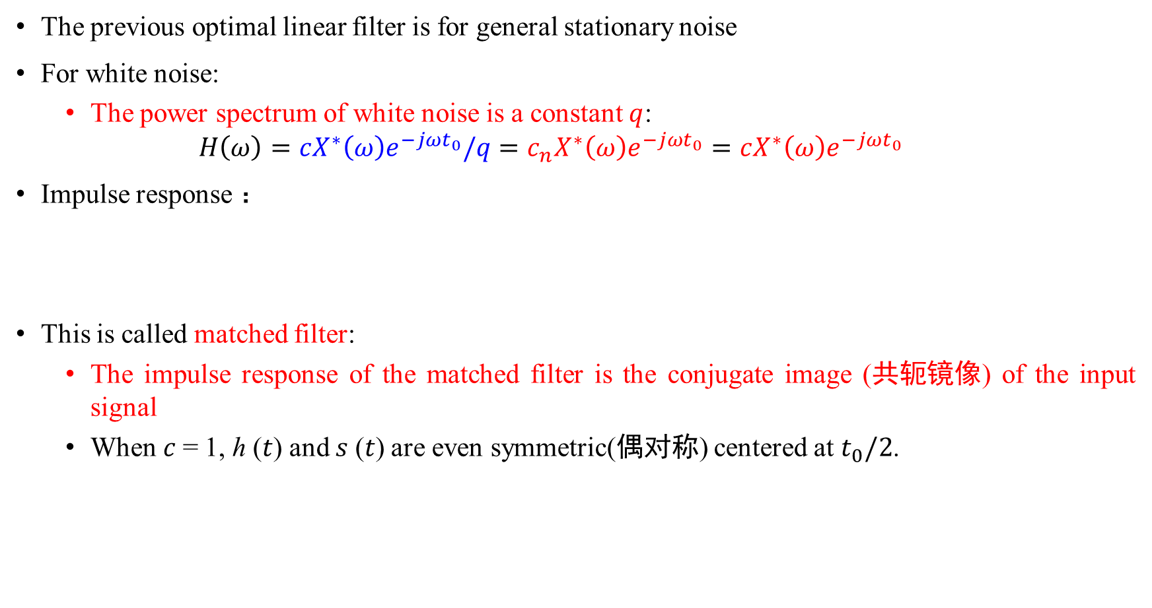


Matched filter (page 24 of lesson 11)
The previous optimal linear filter is for general stationary noise
For white noise:
The power spectrum of white noise is a constant $q$:
$$H\left(ω\right)=cX^{∗}\left(ω\right)e^{−jωt_{0}}/q=c_{n}X^{∗}\left(ω\right)e^{−jωt_{0}}=cX^{∗}\left(ω\right)e^{−jωt_{0}}$$
Impulse response ：
This is called matched filter:
The impulse response of the matched filter is the conjugate image (共轭镜像) of the input signal
When 𝑐 = 1, ℎ (𝑡) and 𝑠 (𝑡) are even symmetric(偶对称) centered at $t_{0}/2$.
$c$ is a constant, which can be assigned a new constant $c_{n}=c/q$, and it can be simplified written as $c$
Fourier transformation
$$h\left(t\right)=cx^{∗}\left(t_{0}−t\right)$$
$$h\left(t\right)=cx\left(t_{0}−t\right)$$
If it's a real signal

Slide 13

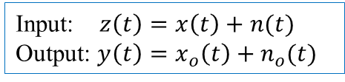





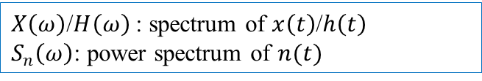

Matched filter (page 26 of lesson 11)
Input: $z\left(t\right)=x\left(t\right)+n(t)$ Output: $y\left(t\right)=x_{o}\left(t\right)+n_{o}(t)$
$X\left(ω\right)$/$H\left(ω\right)$: spectrum of $x\left(t\right)$/$h\left(t\right)$
$S_{n}\left(ω\right)$: power spectrum of $n(t)$
Properties of matched filter
Note that for matched filter, the filter is $h\left(t\right)=cx^{∗}\left(t_{0}−t\right)$
Property 2: $t_{0}$should be larger then the duration time of signal $x(t)$; the ℎ (𝑡) and 𝑠 (𝑡) are even symmetric(偶对称) centered at $t_{0}/2$.
From $h\left(t\right)=cx^{∗}\left(t_{0}−t\right)$:
For a physically realizable system $h\left(t\right)$, we always have $h\left(t\right)=0$ for $t<0$.
Take the following real signal as an example:
$$x\left(t\right)$$
It works!
$$x\left(t\right)$$
$$h\left(t\right)$$
$$t_{1}$$
$$t_{1}$$
$$\frac{t_{0}}{2}$$

Slide 14
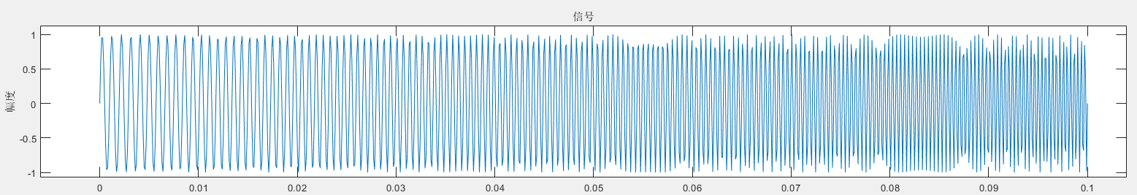
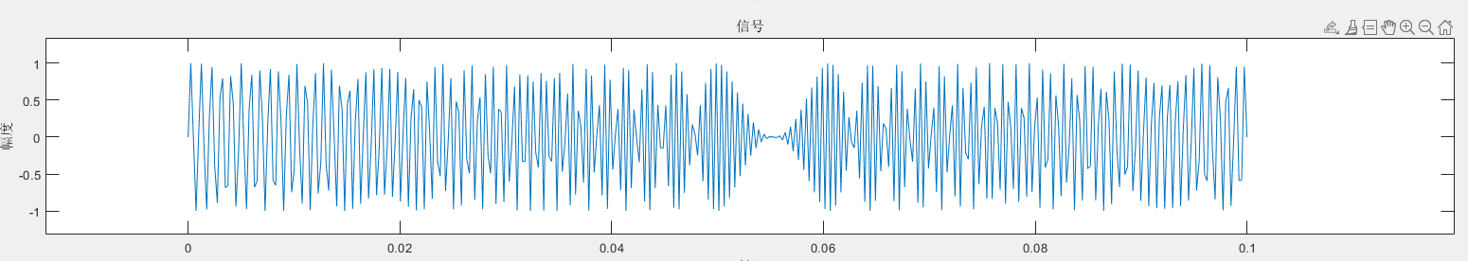
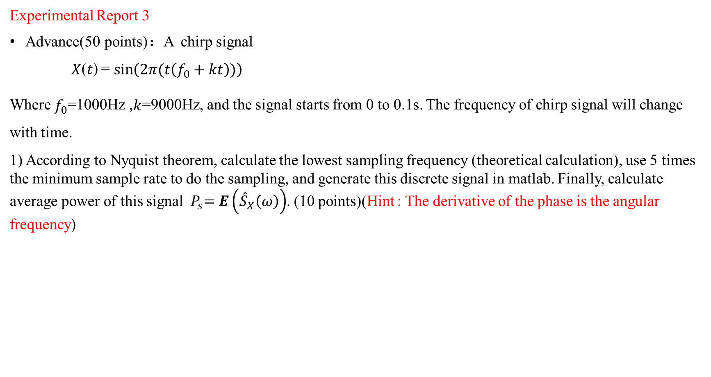
Experimental Report 3
Advance(50 points)：A chirp signal
𝑋(𝑡) = $\sin\left(2π(t\left(f_{0}+kt\right))\right)$
Where $f_{0}$=1000Hz ,$k$=9000Hz, and the signal starts from 0 to 0.1s. The frequency of chirp signal will change with time.
1) According to Nyquist theorem, calculate the lowest sampling frequency (theoretical calculation), use 5 times the minimum sample rate to do the sampling, and generate this discrete signal in matlab. Finally, calculate average power of this signal${ P}_{s}=E\left({\hat{S}}_{X}\left(ω\right)\right)$. (10 points)(Hint : The derivative of the phase is the angular frequency)
Sample rate = 10000Hz
true
Sample rate = 4000Hz
wrong

Slide 15
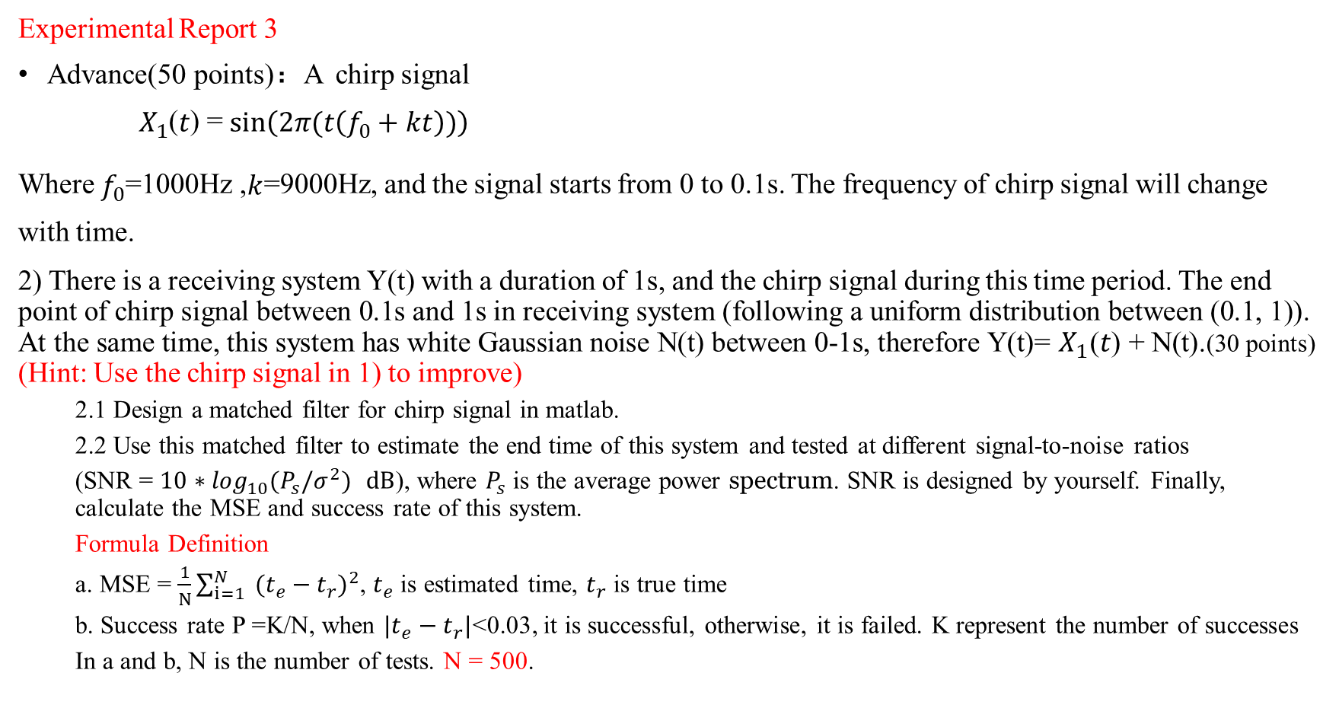
Experimental Report 3
Advance(50 points)：A chirp signal
$X_{1}$(𝑡) = $\sin\left(2π(t\left(f_{0}+kt\right))\right)$
Where $f_{0}$=1000Hz ,$k$=9000Hz, and the signal starts from 0 to 0.1s. The frequency of chirp signal will change with time.
2) There is a receiving system Y(t) with a duration of 1s, and the chirp signal during this time period. The end point of chirp signal between 0.1s and 1s in receiving system (following a uniform distribution between (0.1, 1)). At the same time, this system has white Gaussian noise N(t) between 0-1s, therefore Y(t)= $X_{1}$(𝑡) + N(t).(30 points) (Hint: Use the chirp signal in 1) to improve)
2.1 Design a matched filter for chirp signal in matlab.
2.2 Use this matched filter to estimate the end time of this system and tested at different signal-to-noise ratios
(SNR = $10∗\log_{10}(P_{s}/σ^{2}){ }dB$), where $P_{s}$ is the average power spectrum. SNR is designed by yourself. Finally, calculate the MSE and success rate of this system.
Formula Definition
a. MSE = $\frac{1}{N}\sum_{i=1}^{N}{ }{(t_{e}−t_{r})}^{2}$, $t_{e}$ is estimated time, $t_{r}$ is true time
b. Success rate P =K/N, when ${|t}_{e}−t_{r}|$<0.03, it is successful, otherwise, it is failed. K represent the number of successes
In a and b, N is the number of tests. N = 500.

Slide 16
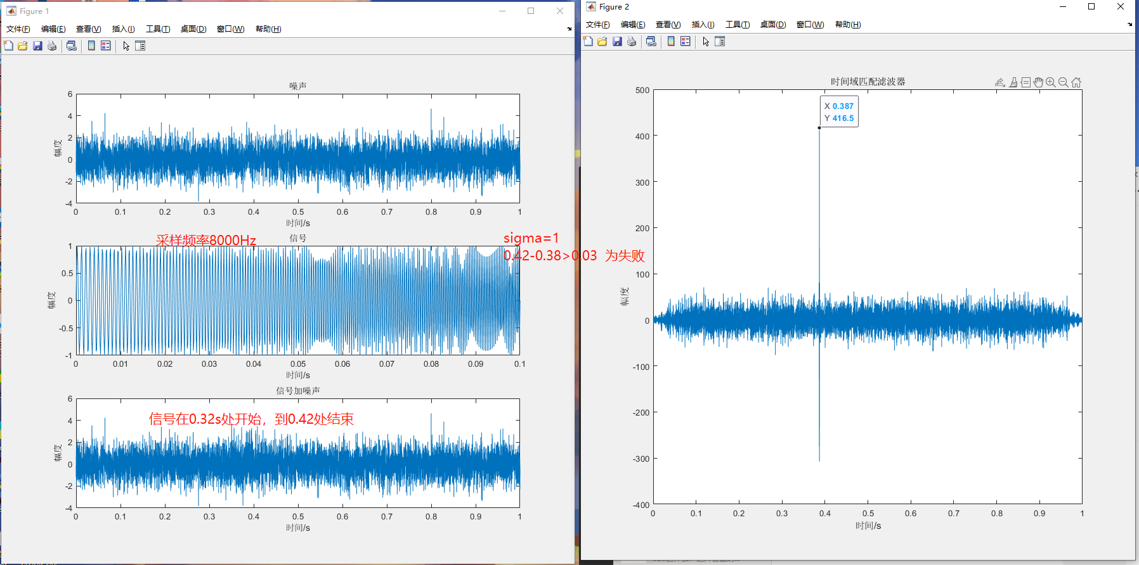

Experimental Report 3
Advance(50 points)：A chirp signal
𝑋(𝑡) = $\sin\left(2π(t\left(f_{0}+kt\right))\right)$
Where $f_{0}$=1000Hz ,$k$=9000Hz, and the signal starts from 0 to 0.1s. The frequency of chirp signal will change with time.
2) There is a receiving system with a duration of 1s, and the chirp signal during this time period. The end point of chirp signal between 0.1s and 1s in receiving system (following a uniform distribution between [0.1, 1]). At the same time, this system has white Gaussian noise between 0-1s. (Hint: Use the chirp signal in 1) to improve)
2.1 Design a matched filter for chirp signal in matlab.
2.2 Use this matched filter to estimate the end time of this system and tested at different signal-to-noise ratios
(SNR = $10∗\log_{10}(P_{s}/σ^{2}){ }dB$), where $P_{s}$ is the average power spectrum. SNR is designed by yourself. Finally, calculate the MSE and success rate of this system.
Formula Definition
a. MSE = $\frac{1}{N}\sum_{i=1}^{N}{ }{(t_{e}−t_{r})}^{2}$, $t_{e}$ is estimated time, $t_{r}$ is true time
b. Success rate P =K/N, when ${|t}_{e}−t_{r}|$<0.03, it is successful, otherwise, it is failed. K represent the number of successes
In a and b, N is the number of tests. N = 500.

Slide 17
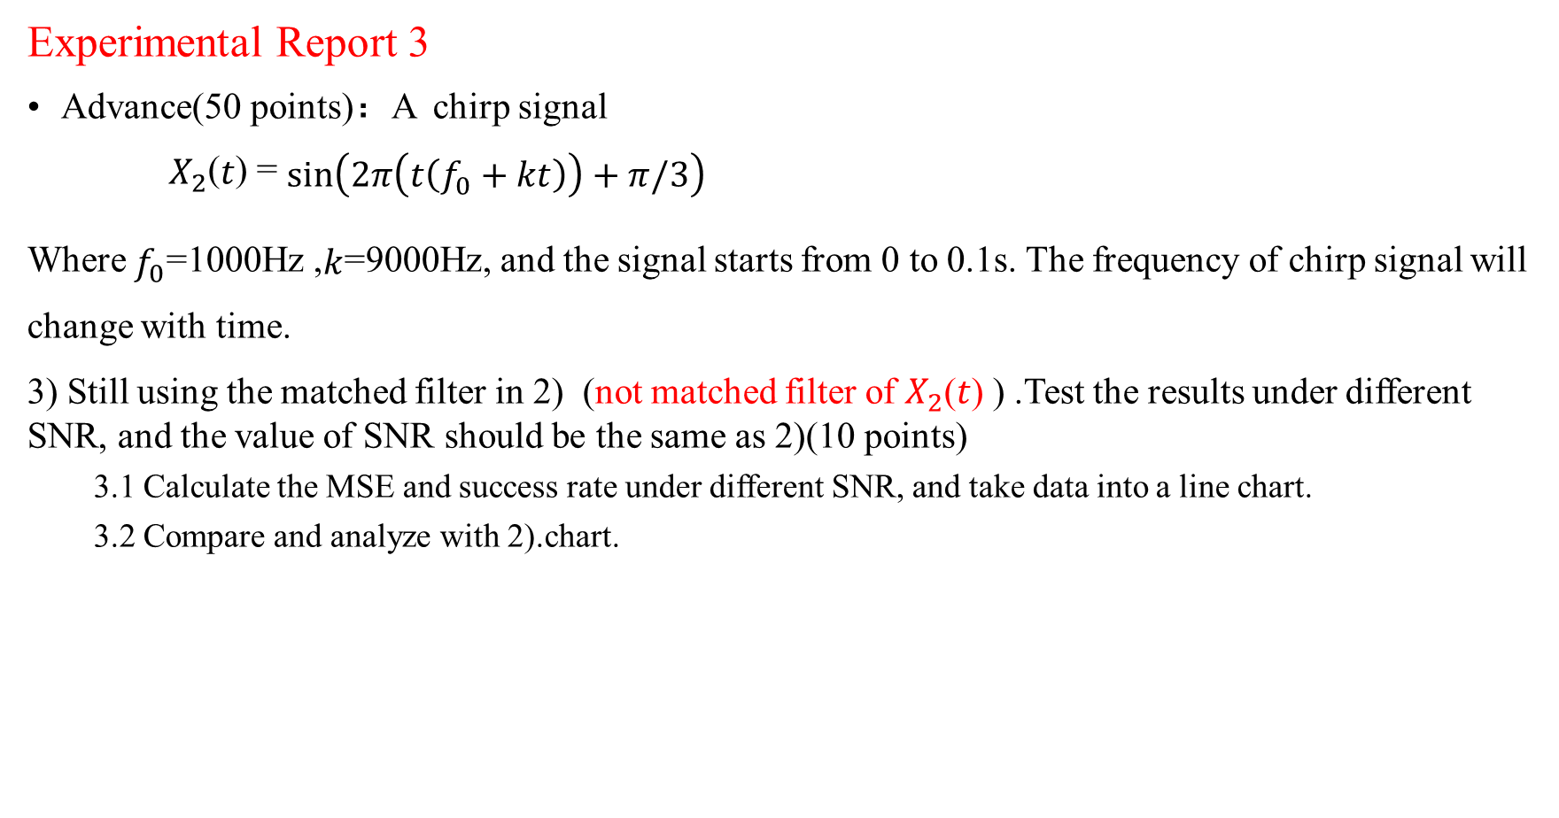
Experimental Report 3
Advance(50 points)：A chirp signal
$X_{2}$(𝑡) = $\sin\left(2π\left(t\left(f_{0}+kt\right)\right)+π/3\right)$
Where $f_{0}$=1000Hz ,$k$=9000Hz, and the signal starts from 0 to 0.1s. The frequency of chirp signal will change with time.
3) Still using the matched filter in 2) (not matched filter of $X_{2}$(𝑡) ) .Test the results under different SNR, and the value of SNR should be the same as 2)(10 points)
3.1 Calculate the MSE and success rate under different SNR, and take data into a line chart.
3.2 Compare and analyze with 2).chart.

Slide 18
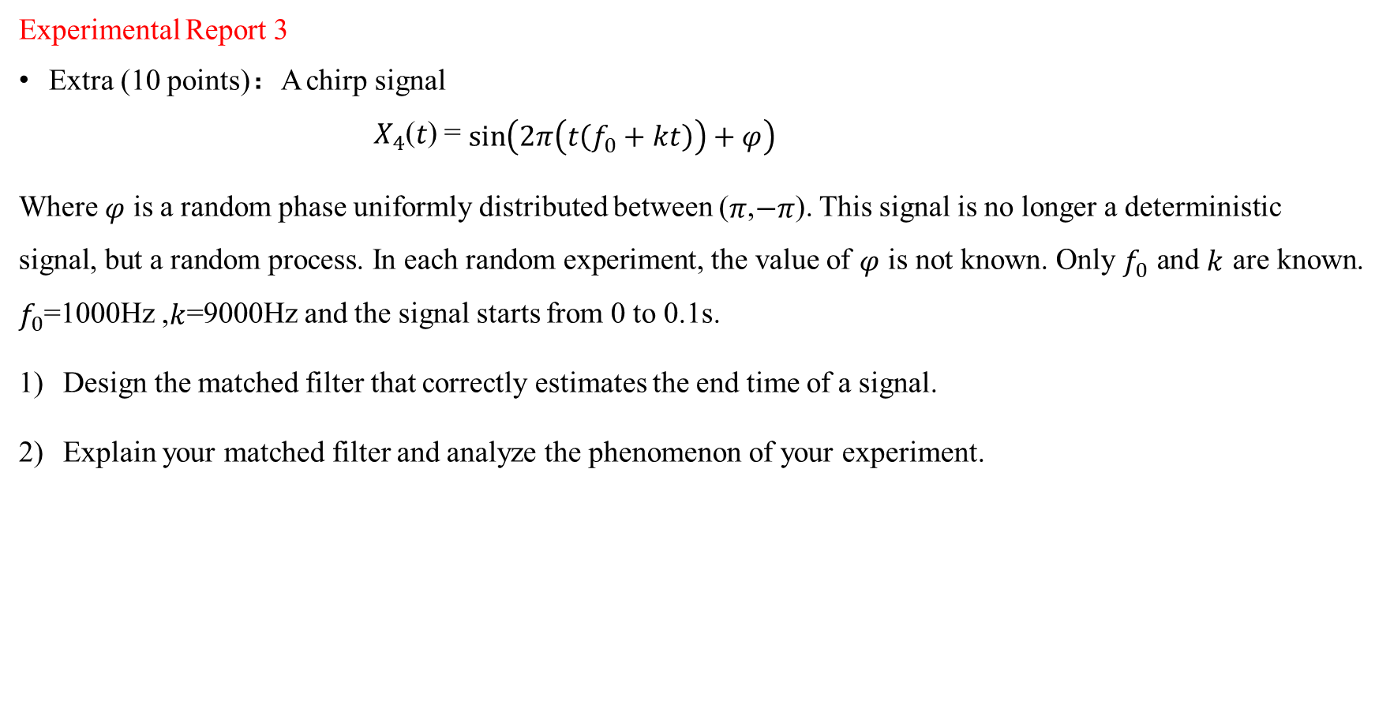
Experimental Report 3
Extra (10 points)：A chirp signal
$X_{4}$(𝑡) = $\sin\left(2π\left(t\left(f_{0}+kt\right)\right)+φ\right)$
Where $φ$ is a random phase uniformly distributed between ($π$,$−π$). This signal is no longer a deterministic signal, but a random process. In each random experiment, the value of $φ$ is not known. Only $f_{0}$ and $k$ are known. $f_{0}$=1000Hz ,$k$=9000Hz and the signal starts from 0 to 0.1s.
Design the matched filter that correctly estimates the end time of a signal.
Explain your matched filter and analyze the phenomenon of your experiment.

